Slide 1

Computer System Servicing

Slide 2
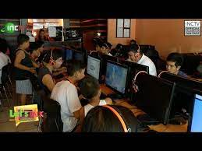
Motivation:

Slide 3
Components of Peer to Peer Network Design

Slide 4

Components of Peer to Peer Network Design
INTERNET SERVICE PROVIDER (ISP)
An organization that provides services for accessing, or participating in the internet. ISP can be organized in various forms, such as commercial, community-owned, non-profit, or otherwise privately owned.

Slide 5
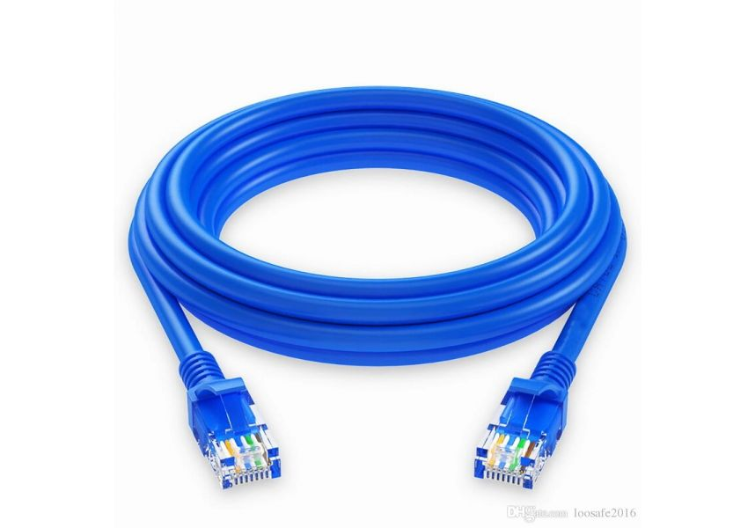
Components of Peer to Peer Network Design
2. NETWORK CABLE
Use to connect one network device to other network device or to connect two or more computers to share files and printer.

Slide 6
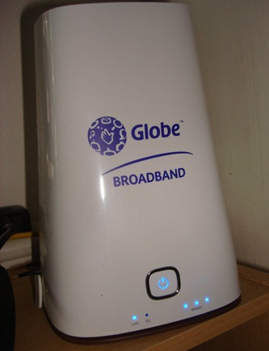
Components of Peer to Peer Network Design
3. MODEM
A device that converts data into a format suitable for a transmission medium so that it can be transmitted from one computer to another.

Slide 7
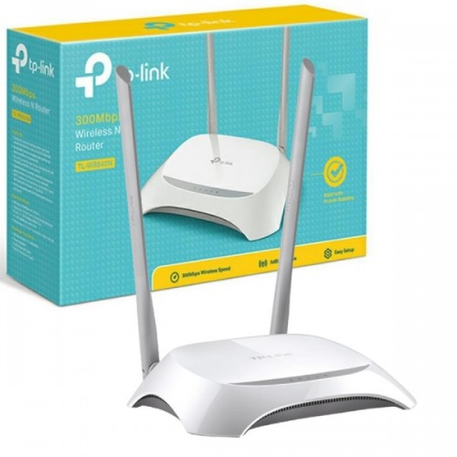
Components of Peer to Peer Network Design
4. ROUTER
A device that forwards data packets between computer networks.

Slide 8

Components of Peer to Peer Network Design
5. PERSONAL COMPUTER (PC)
A multi-purpose computer whose size, capabilities, and price make it feasible for individual use.

Slide 9
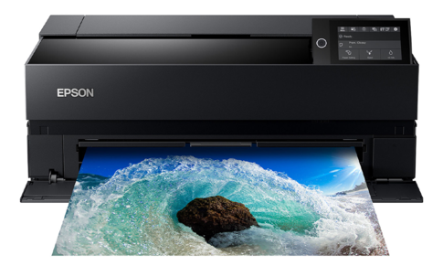
Components of Peer to Peer Network Design
6. PRINTER
A peripheral device which makes a persistent representation of graphics or text, usually on paper.

Slide 10
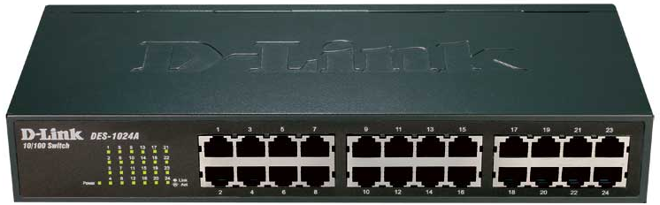
Components of Peer to Peer Network Design
7. HUB/Switch
A device that filters and forwards data packets between LAN segments.

Slide 11
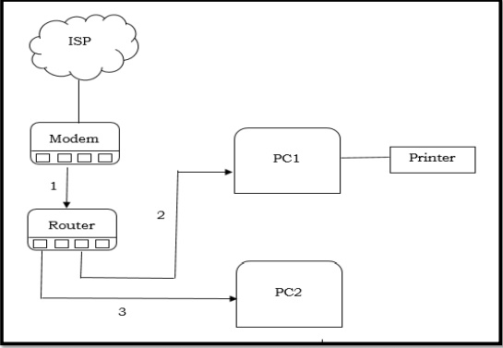
Cable routes of Peer to Peer Network Design

Slide 12
FORMATIVE ASSESSMENT
Direction: Cite the cable routes in Peer to Peer Network Type.
Available Devices:
1. Modem
2. Router
3. ISP
4. HUB/Switch
5. 2 sets of PC
6. Network Cables
7. Printer

Slide 13
Practical Application of the acquired
Learning Competencies

Slide 14

GENERALIZATION

Slide 15
THANK YOU!!!

